Slide 1
Introduction to Global Securities Market
国际证券市场简介
College of Software Technology, Zhejiang University
浙江大学软件学院
May 19-20, 2018
Edward Li, CFA, FRM
ecli_99@yahoo.com

Slide 2
Leaning Objectives
Gain a solid understanding of fundamental concepts related to stock markets including markets, participants, types and basic valuation methods.
Quiz will be given at the end of the class

Slide 3
Agenda
    International Financial Markets
      International Markets overview
    The Time Value of Money: Math Mechanics
    International Stock Markets
      Stock Basics
      Stock Markets Trading Flow
    Stock Trade Operation
      Terminals
      Orders
    Stock Analysis
      Fundamental Analysis
      Technical Analysis

Slide 4
Session 1
International Financial Markets

Slide 5
Financial Markets: Economic Background
Four groups of “actors” in a simplified picture of the economy:
  Households
  Businesses
  Government
  Financial Sector
Households receive income from selling the factors of production (land, labor, capital) which they own. Households spend their income on goods and services produced by businesses.
Businesses buy the factors of production from households and sell the products they produce back to households.
Government receives revenue and spends money providing government goods and services and transfer payments.
Financial institutions receive savings from households, businesses, and the government and invest these savings.

Slide 6
The Cycle of Money
Financial intermediaries assist in the movement of money, from lenders to borrowers and back again.
  This process is termed the cycle of money and its main objective is to make all the participants better off

Slide 7
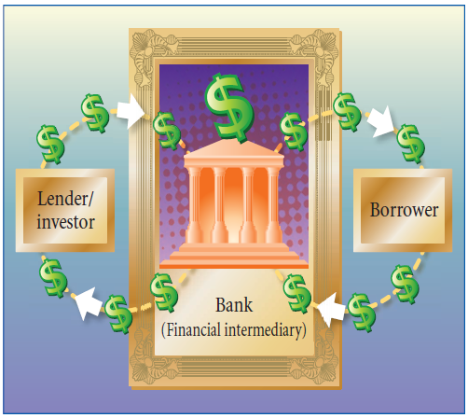
The Cycle of Money (Cont’d)

Slide 8
The Cycle of Money - Example
Example: A mutual fund issues shares which are bought by individuals
The pooled funds are invested by the mutual fund company in shares that are issued by firms
The firms pay dividends periodically which are received by the mutual fund and passed through to their shareholders, or reinvested in additional shares and the cycle of money starts again.
  The mutual fund managers earn fees;
  the firms whose securities are bought are able to raise capital for growth and future returns; and
  the mutual fund shareholders earn dividends and capital gains.
Thus, all participants are generally better off.

Slide 9
Financial Markets: Flow of Funds
Flow of funds from saver-lenders to borrower-spenders
Indirect Finance 间接金融
Financial Intermediaries
金融中介
$
$
$
Saver
Lenders
贷款人
Borrower
Spenders
借款人
$
Financial Markets
金融市场
$
Households 家庭
Businesses 业务
Government 政府
Foreigners 外国人
Businesses 业务
Government 政府
Households 家庭
Foreigners 外国人
Direct Finance
直接金融
Source: Wall Street – The Economist

Slide 10
Financial Markets (cont.)
Fundamental function:
the transfer of funds from individuals or institutions with surplus funds (savers-lenders) to those who require funds (borrowers-spenders).
It channels funds from parties that do not have productive use for them to those that do.
Indirect finance: via financial intermediaries – banks, savings institutions, and investment intermediaries
Direct finance: via financial markets – the purchase of securities (debt and equity) issued by borrowers-spenders by saver-lenders themselves or by financial intermediaries
Pricing Setting: trading thru supply and demand of financial assets. If demand exceeds supply price will rise, and vice versa.

Slide 11
Financial Markets (cont.)
Asset Valuation: market price provides a detached basis for determining the value of individual assets and corporations
Fund Raising: IPO (Initial Public Offering)
Income & Savings: earn a return on their funds, to accumulate assets that will provide future income
Arbitrage: transparency of market prices leads to reduction of price discrepancies, making for greater economic efficiency
Risk Management: futures, options, and other derivatives contracts: hedging
Watchdog: make sure the investors’ investment safe, like SEC

Slide 12
Characteristics of a Good Market
Provide timely and accurate information
Provide liquidity
Have good internal and external efficiency
Good markets provide:
  Liquidity
  Continuous information

Slide 13
Market Participants
There are two basic financial market participant categories:
  Investor vs. Speculator
  Institutional vs. Retail
An investor is any party that makes an investment.
A speculator, involves in the buying, holding, selling and short selling of stocks, bonds, commodities, currencies, real estate, derivatives, or any valuable financial instrument to profit from fluctuations in its price as opposed to buying it for use or for income via methods such as dividends or interest.
An institutional investor is an investor, such as a bank, insurance company, retirement fund, hedge fund, or mutual fund, that is financially sophisticated and makes large investments, often held in very large portfolios of investments. Because of their sophistication, institutional investors may often participate in private placements of securities, in which certain aspects of the securities laws may be inapplicable.
A retail investor is an individual investor possessing shares of a given security.

Slide 14
Buy Side vs. Sell Side
Buy side comprises the investing institutions (asset owners) such as mutual funds, pension funds and insurance firms that tend to buy large portions of securities for money-management purposes.
Sell side refers to banks and brokerages who are required to be market makers in a given security.

Slide 15
Financial Instruments 金融工具
Equity Markets
Bond Markets
Money Markets
Foreign-exchange (Forex) Markets
Securitization (e.g. ABS, MBS)
Commodities & Futures Markets
Options & Derivatives Markets

Slide 16
Session 2
The Time Value of Money

Slide 17
The value of money at the end of the stated period is called the future or compound value of that sum of money.
  Determine the attractiveness of alternative investments
  Figure out the effect of inflation on the future cost of assets, such as a car or a house.

Slide 18
The Single-Period Scenario
FV = PV + PV x interest rate, or
FV = PV(1+interest rate)
(in decimals)
Example 1: Let’s say Jay deposits $200 for a year in an account that pays 6% per year. At the end of the year, he will have:
FV = $200 + ($200 x .06) = $212
  = $200(1.06) = $212

Slide 19
The Multiple-Period Scenario
FV = PV x (1+r)^{n}
Example 2: If John closes out his account after 3 years, how much money will he have accumulated? How much of that is the interest-on-interest component? What about after 10 years?
FV₃ = $200(1.06)³ ⁼ $200*1.191016 = $238.20,
where, 6% interest per year for 3 years = $200 x.06 x 3=$36
Interest on interest = $238.20 - $200 - $36 =$2.20
FV₁₀ = $200(1.06)¹⁰ = $200 x 1.790847 = $358.17
where, 6% interest per year for 10 years = $200 x .06 x 10 = $120
Interest on interest = $358.17 - $200 - $120 = $38.17

Slide 20
Methods of Solving Future Value Problems
Method 1: The formula method
  Time-consuming, tedious
Method 2: The financial calculator approach
  Quick and easy
Method 3: The spreadsheet method
  Most versatile
Method 4: The use of Time Value tables:
  Easy and convenient but most limiting in scope

Slide 21
Present Value and Discounting
Involves discounting the interest that would have been earned over a given period at a given rate of interest.
It is therefore the exact opposite or inverse of calculating the future value of a sum of money.
Such calculations are useful for determining today’s price or the value today of an asset or cash flow that will be received in the future.
The formula used for determining PV is as follows:
PV = FV x 1/ (1+r)^{n}

Slide 22
The Single-Period Scenario
When calculating the present or discounted value of a future lump sum to be received one period from today, we are basically deducting the interest that would have been earned on a sum of money from its future value at the given rate of interest.
i.e. PV = FV/(1+r)➔ since n = 1
So, if FV = 100; r = 10%; and n =1;
➔PV = 100/1.1=90.91

Slide 23
The Multiple-Period Scenario
When multiple periods are involved…
The formula used for determining PV is as follows:
PV = FV x 1/(1+r)^{n}
where the term in brackets is the present value interest factor for the relevant rate of interest and number of periods involved, and is the reciprocal of the future value interest factor (FVIF)

Slide 24
Present Value and Discounting (Cont’d)
Example: Discounting Interest
Let’s say you just won a jackpot of $50,000 at the casino and would like to save a portion of it so as to have $40,000 to put down on a house after 5 years. Your bank pays a 6% rate of interest. How much money will you have to set aside from the jackpot winnings?

Slide 25
Present Value and Discounting (Cont’d)
Example (Answer)
FV = amount needed = $40,000
N = 5 years; Interest rate = 6%;
PV = FV x 1/ (1+r)^{n}
PV = $40,000 x 1/(1.06)⁵
PV = $40,000 x 0.747258
PV = $29,890.33➔ Amount needed to set aside today

Slide 26
One Equation and Four Variables
Any time value problem involving lump sums -- i.e., a single outflow and a single inflow--requires the use of a single equation consisting of 4 variables i.e. PV, FV, r, n
If 3 out of 4 variables are given, we can solve the unknown one.
FV = PV x (1+r)^{n} ➔solving for future value
PV = FV X [1/(1+r)^{n}] ➔solving for present value
r = [FV/PV]^{1/n} – 1 ➔solving for unknown rate
n= [ln(FV/PV)/ln(1+r)] ➔solving for # of periods

Slide 27
Session 3
International Stock Markets

Slide 28
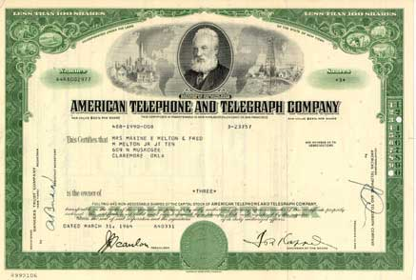
Sample Stock

Slide 29
Definition
A share in the ownership of a company. Stock represents a claim on the company's assets and earnings.
Profits are sometimes paid out in the form of dividends.
Without dividends an investor can make money on a stock only through its appreciation in the open market.
A corporation is a form of business enterprise that is a legal entity.
A stock certificate constitutes physical evidence of ownership
The governing authority of the corporation is the Board of directors

Slide 30
How a corporation raises capital?
Debt financing
Equity financing

Slide 31
Stock Type
Preferred Stock
  Described as equity ownership of a corporation’s shares where the owners are entitled to regular fixed dividend before a dividend can be paid to common stock holders.
  Intended for investors who are more interested in income than capital appreciation
  Preferred stockholders usually do not have voting rights
Common Stock
  Security representing (partial) ownership of a company’s assets, generally with the right to participate in dividends and in most cases to vote on major matters affecting stockholder interests.
Convertible Bond

Slide 32
Stock Type (cont.)
Class A Stock
  It is the stock issued for public trading from an IPO or if a company issues new stock at a later date.
Class B Stock
  It is a special category of stock usually retained by company founders at the time a company goes public. It carries certain rights not granted to stock available to the public. One of those rights is one share of Class B stock has 10 votes while regular shares have only one vote.
The portion of a company’s profit paid to shareholders is called a:Dividend

Slide 33
Stock Type (cont.)
Warrants
  Give stockholders the right to buy stock at subscription price
  It has a value of its own and can be traded on the open market

Slide 34
Stock Type (cont.)
Blue-chip stocks are those that are high-grade issues of major companies that have long and unbroken records of earnings and dividend payments
Income stocks pay higher than average dividends and are purchased by those who buy stock for current income
Foreign stocks traded in U.S. markets are called American Depository Receipts (ADRs)

Slide 35
Stock Type (cont.)
The classification of stock:
  Blue-chip (high-grade issues of major companies that have long and unbroken records of earnings and dividend payments; e.g. IBM and GE)
  Growth (faster-than-average gains in earnings over the last few years and is expected to continue to show high levels of profit growth; usually with high price/earnings ratios and little or no dividend payments to shareholders)
  Defensive ((has a resistance to a recession; e.g. food companies, utilities, and tobacco companies)
  Cyclical (sensitive to business cycles)

Slide 36
Stock Split
A stock split does the following:
  Decrease par value
  Make the stock more marketable
  Reduce the market price of the stock
A stock split will NOT change the net dollar value in a stock
Stock split example: 2-for-1; 1,000 shares and $50 per share (after split, you’ll have 2,000 shares and $25 per share)
A reverse stock split creates a smaller number of shares and increase the market price; example: 1-for-5; 10,000 shares and $1 per share (you’ll have 2,000 shares and $5 per share)

Slide 37
Market Players
Institutional Investors
  Organization whose function is to invest assets on behalf of others
  Central Banks, Pension Funds (e.g.: Calpers, NCSSF), Mutual Funds, …
Fund Managers
  Any individual firm which has responsibility for managing a fund or investment portfolio
  Fidelity, Vangurard
Brokers/Dealers
  Any individual or firm acting as an agent for buyers & sellers & charging a commission
  -Goldman Sachs, Morgan Stanley
Global Custodians
  The keeper of international securities & other assets on behalf of investor
  -State Street, Bank of New York, JP Morgan Chase, Northern Trust
Sub-Custodians
  Local equivalent of global custodians
  Standard Chartered Bank, HSBC, Citibank, Bank of China，。。。

Slide 38
Stock Exchange
The New York Stock Exchange (NYSE)
The American Stock Exchange (AMEX)
The London Stock Exchange (LSE)
NASDAQ Stock Market (National Association of Securities Dealers Automated Quotations)
Boston Stock Exchange (BSE)

Slide 39
Stock Markets Type
Primary Market (IPO)
  The primary market is that part of the stock markets that deals with the issuance of new stocks.
  Initial Public Offering (IPO), referred to simply as a "public offering," is the first sale of stock by a private company to the public. IPOs are often issued by smaller, younger companies seeking capital to expand, but can also be done by large privately-owned companies looking to become publicly traded.
Secondary Market
  The secondary market is the financial market for trading of securities that have already been issued in an initial private or public offering. Once a newly issued stock is listed on a stock exchange, investors and speculators can easily trade on the exchange, as market makers provide bids and offers in the new stock.
OTC Market
  An over-the-counter market is a financial market where products are traded over-the-counter. It is contrasted with exchange trading, which occurs via corporate-owned facilities constructed for the purpose of trading

Slide 40
Over the Counter Markets
To be traded on the over the counter markets, a stock must have: a market maker

Slide 41
Third Market
Stocks listed on a registered exchange may also be traded in the Over the Counter market
Non-member investment firms can make markets in and trade registered securities without going through the exchange.
This segment of the OTC market is called the Third Market.

Slide 42
Fourth Market
The sale of shares between two institutions is called: Fourth market
Directly negotiated sales are done by investors to save transaction costs

Slide 43
New Shares
New shares of firms already trading on the exchange are called: seasoned issues

Slide 44
Primary Market Trade Flow
Issuer
发行者
发行
Bonds 债券
Equities 股票
….
Financial Intermediaries
金融中介

Slide 45
Role of an Underwriter
An underwriter provides:
Origination
Risk bearing
Distribution

Slide 46
Secondary Market Trade Flow ( Exchange Trading)
Retail
Investor
零售投资者
Stock
Exchange
证券交易所
Broker /
Dealer
经纪人/经销商
Institutional
Investor
机构投资者
Depository
托存
Sub-
Custodian
本地托管行

Slide 47

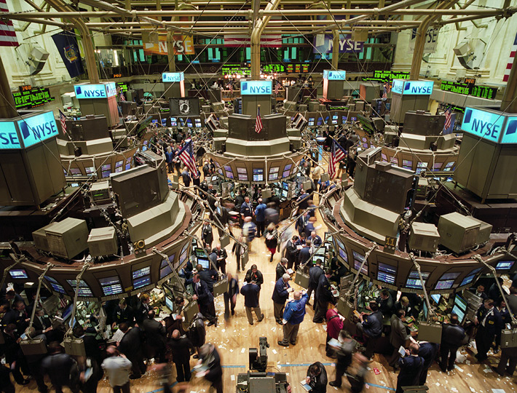
NYSE
Largest, the most prestigious
security exchange in the world
Floor Exchange
Auction
Specialist (Market makers)

Slide 48




A retail trade in a NYSE
Floor Broker & Specialist
Client
Broker

Slide 49
Market Indexes
The use of security market indexes are:
  To measure portfolio performance over various time periods
  To help in the construction of index portfolios
  To examine the factors that influence aggregate security price movements
  To aid market technicians in their investment decisions
  To help in the calculation of beta and portfolio theory studies
Factors in Constructing Market Indexes:
  The sample must be representative of the population
  Decide the weighting to give the individual items in the sample
  Decide on the mathematical or computational procedure to combine the individual items into the whole index

Slide 50
Market Indexes
Two major series types:
  Price Weighted Series
  Market Value Weighted Series
A price weighted series is an arithmetic average of current prices, thus price movements are influenced by the differential prices of the components
Formula: Adds together the market price of each stock in the index and then divides this total by the number of stocks in the index
The Dow Jones Industry Average is a price weighted index that used 30+ stocks

Slide 51
Market Indexes
A Market Value Weighted Series is calculated by summing the total value (current stock price times the number of shares outstanding) of all stocks in the index. This sum is then divided by a similar sum calculated during the selected base period. This ratio is then multiplied by the index’s base beginning value.
The value weighted index assumes you make a proportionate market value investment in each company in the index.
The major problem with a value weighted index is that firms with greater market capitalization have a greater impact on the index than do firms with lower market capitalization.
Major indexes:
  Standard & Poor’s 500
  New York Stock Exchange Index
  NASDAQ Series
  International Indexes (e.g. MSCI)

Slide 52
Roles in Trading
Broker:
  Execute orders for floor brokers
Catalyst
  Bring buyers and sellers together enabling a transaction to take place that otherwise would not have occurred.
Dealer
  Provide capital to minimize the imbalance.
Auctioneer
  Manage the auction process
  Establish the opening price for his security every day.

Slide 53
Roles in Trading (cont.)
Specialist
  Have to quote firm two-sided markets during trading hours.
  Have an obligation to smooth price by intervening to prevent large price reversals (provide price continuity).
  Many specialists are forced to hold an inventory of shares themselves to minimize the imbalance of buy and sell orders
  Revenue
    Commission
    Profits from dealing
  Privileges
    Access to information about order flows
    the ability to create the market quote
    the right to collect brokerage commissions from executing system order flow

Slide 54
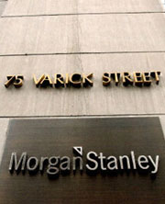


An institutional trade in a NYSE
Portfolio manager
POSIT
The world's largest equity crossing system, matches institutional buyers and sellers anonymously
Trader

Slide 55
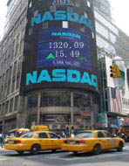
NASDAQ
National Association of Security Dealers Automated Quotations
OTC
Computer and telecommunications network
Market Maker Trading System
Listing requirements are less stringent than those of the registered exchange

Slide 56

A retail trade in a NASDAQ
Client
Market Maker
Broker

Slide 57

An institutional trade in a NASDAQ
Market Maker
Portfolio manager
Trader

Slide 58
Session 4
Stock Trading Operation

Slide 59
Terminals

Slide 60
Terminologies on Terminal
Order
Trade
Share
Share Price
Sell/Buy
Ask/Bid
Spread
T+1, T+0
Short Sell
Commission

Slide 61
Terminologies on Terminal (cont.)
Last Price
Change
Currency
% Change
Open
Day Low
Day High
Volume

Slide 62
Short Sale
The requirements that a short sale can only occur at a higher price than the last previously changed price is called:
The up tick rules

Slide 63
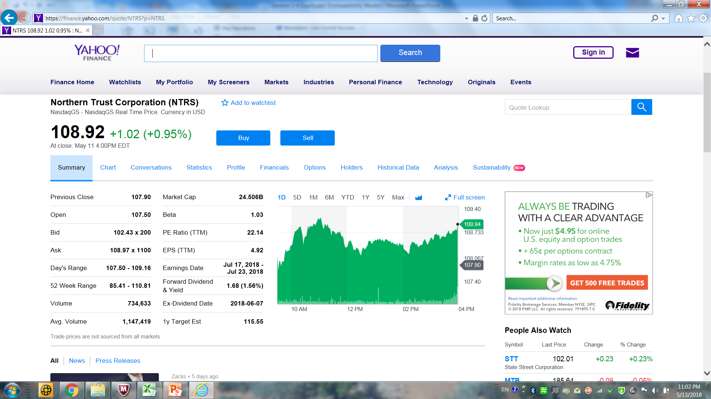
Web-based Stock Information--Yahoo

Slide 64
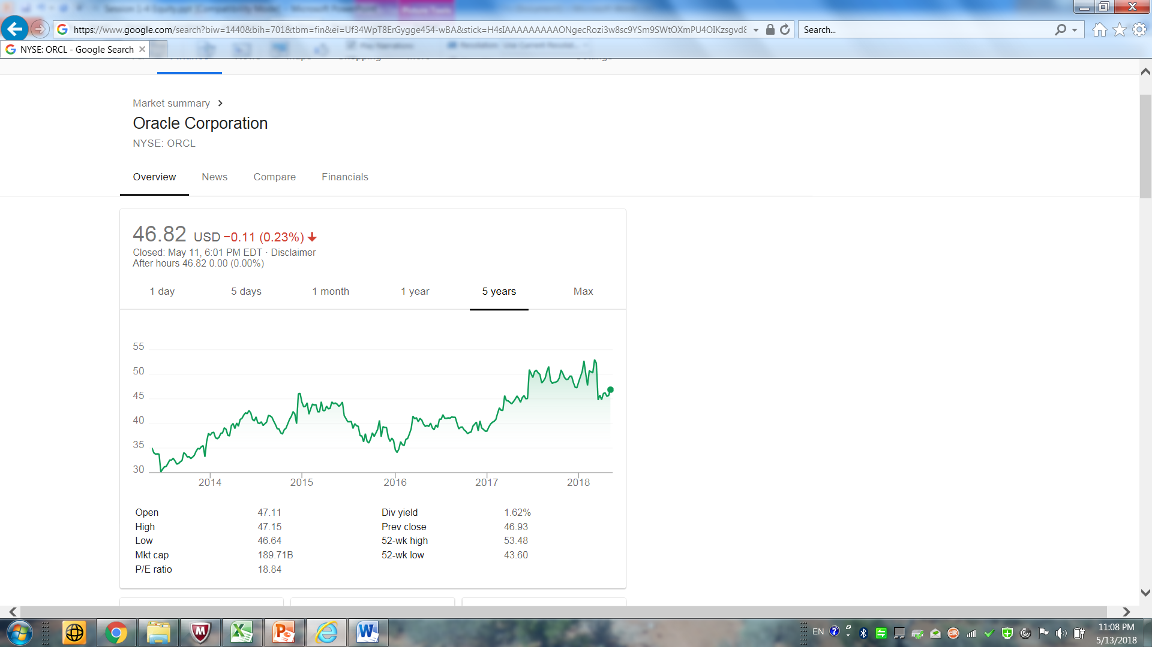
Web-based Stock Information--Google

Slide 65
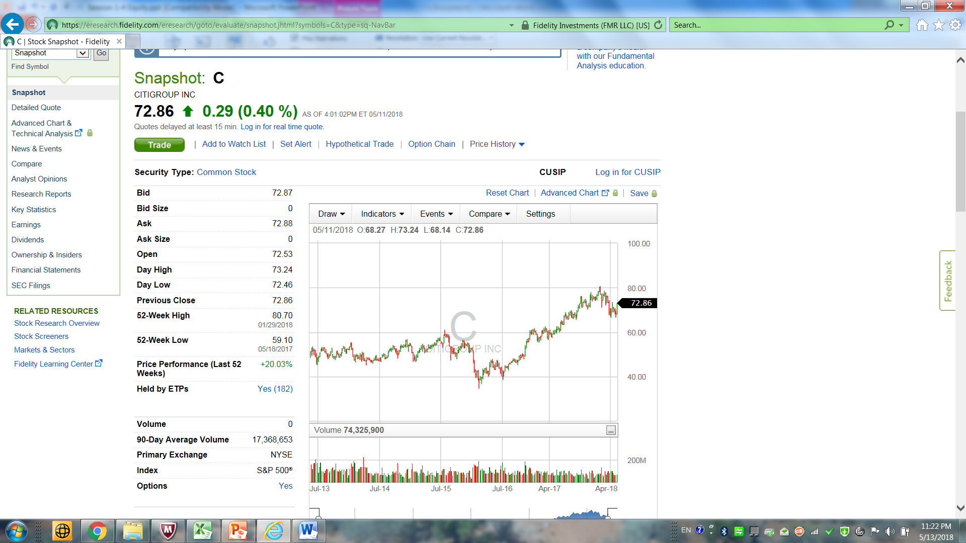
Web-based Research and Trading – Fidelity

Slide 66
Stock Identifiers

Slide 67
Asset Identifiers
Numbering systems have been implemented which serve to identify specific classifications of a security.
With the complex structure of various markets, asset identifiers facilitate global trading, clearing and settlement activities.
There are various asset identifier numbering systems in use by various markets.

Slide 68
Asset Identifiers (cont.)
CUSIP (Committee on Uniform Security Identification Procedures)
  An identifier which is used for most US and Canadian securities.
  The nine alphanumeric code that reflects three different aspects of security. (Apple Inc.: 037833100)
CINS
  An acronym standing for the "CUSIP International Numbering System," which provides identification of international securities.
ISIN (International Securities Identifying Number)
  One universal security system worldwide.
  12-character alpha-numerical code (Apple Inc.: ISIN US0378331005)
SEDOL (Stands for Stock Exchange Daily Official List)
  Identify securities trading on the International Stock Exchange in London

Slide 69
Asset Identifiers (cont.)
Numbering systems have been implemented which serve to identify specific classifications of a security.
With the complex structure of various markets, asset identifiers facilitate global trading, clearing and settlement activities.
There are various asset identifier numbering systems in use by various markets.

Slide 70
Orders

Slide 71
Types of Orders
Market Order: a market order will always be executed immediately, but customers cannot be sure of what the execution price will be
Limit Order: When customers wish to buy or sell securities at a specific price, they enter limit orders. A limit order can only be executed at the specific price or better.
  Buy Limit Order: executed at the limit price or lower
  Sell Limit Order: executed at the limit price or higher

Slide 72
Limit Risks
Stop Order
  A Stop order becomes a market order to buy or sell securities or commodities once the specified stop price is attained or penetrated.
  A Sell Stop order is always placed below the current market price. It is typically used to limit a loss or protect a profit on a long stock position.
  A Buy Stop order is always placed above the current market price. It is typically used to limit a loss or protect a profit on a short sale.
Stop Limit Order
  A Stop Limit order becomes a limit order once the specified stop price is attained or penetrated.
  A STOP-LIMIT order eliminates the risk of a stop order where the investor is not guaranteed an execution price, but exposes the investor to the risk that the order may never be filled even though the stop price has been reached. The investor could "miss the market" in the security or commodity altogether.

Slide 73
Speed of Execution
Market
  A market order is an order to buy or sell an asset at the bid or offer price currently available in the marketplace.
Market If Touched
  An MIT (market-if-touched) is an order to buy (or sell) an asset below (or above) the market. This order is held in the system until the trigger price is touched, and is then submitted as a market order. An MIT order is similar to a stop order, except that an MIT sell order is placed above the current market price, and a stop sell order is placed below.
Market On Open
  A market order executed at the market's open at the market price.
Market On Close
  A market order executed at the market's close at the market price.

Slide 74
Speed of Execution (cont.)
Pegged to Market
  An order that is pegged to buy on the best offer and sell on the best bid.
VWAP (Volumes Weighted Average Pricing)
  The VWAP for a stock is calculated by adding the dollars traded for every transaction in that stock ("price" x "number of shares traded") and dividing the total shares traded. A VWAP is computed from the open of the market to the market close, and is calculated by volume weighting all transactions during this time period.

Slide 75
Price Improvement
Limit
  A limit order is an order to buy or sell a contract at a specified price or better.
Limit If Touched
  An LIT (limit-if-touched) is an order to buy (or sell) an asset below (or above) the market, at the defined limit price or better. This order is held in the system until the trigger price is touched, and is then submitted as a limit order. An LIT order is similar to a stop limit order, except that an LIT sell order is placed above the current market price, and a stop limit sell order is placed below.

Slide 76
Discretion
Discretionary
  A Discretionary Order is a limit order for which you define a discretionary amount (which is added to or subtracted from the limit price) that increases the price range over which the order is eligible to execute. The original limit price is displayed to the market.
Hidden
  A Hidden order (generally a large volume order) shows no evidence of its existence in either the market data or the deep book
Iceberg
  An Iceberg order allows you to submit an order (generally a large volume order) while publicly disclosing only a portion of the submitted order.

Slide 77
Market Timing
All or None
  An AON (all or none) order will remain at the exchange (or in the IB system) until the entire quantity is available to be executed.
Fill or Kill
  A FOK (Fill or Kill) order must execute as a complete order as soon as it becomes available on the market, otherwise the order is canceled.
GTD
  A GTD (Good-till-Date) order valid until the date specified.
GTC
  A GTC (Good-till-Canceled) order is an order to buy or sell a security at a specific or limit price that lasts until the order is completed or cancelled. A GTC order will not be filled until the limit has been reached, no matter how many days or weeks it takes.
IOC
  An IOC (Immediate or Canceled) order requires that all or part of the order be executed as soon as it is brought to the market, whereby the portion not executed is automatically canceled.

Slide 78
Limit Order
Example:
A stock is selling at $100. Your valuation model says it should be selling at $80. If you believe your model, you should: Short the stock at $100
Example:
The current market price of the XYZ Company stock is $50. An order to sell at $55 would be a: Limit order (Sell Limit Order)

Slide 79
Session 5
Analyzing Stocks

Slide 80
Price Changing
Stock prices change according to supply and demand. There are many factors influencing prices, the most important being earnings.
Earnings are the profit a company makes, and in the long run no company can survive without them.
Nobody really knows for sure why stock prices change.

Slide 81
Stock Investment Features
Long term
Clear investing goal and self-acceptance of risk
Emphasize the risk control and have accurate risk budget
Take eyes on the whole portfolio management
Large orders to affect the whole market

Slide 82
Stock Correlation
The correlation between US stock exchanges is relatively high
The correlation between US equity and foreign equity exchange is relatively low

Slide 83
Two Analysis Models
Fundamental Analysis (Buying a Business)
  fundamental analysis is a technique that attempts to determine a security’s value by focusing on underlying factors that affect a company's actual business and its future prospects.
  It maintains that markets may mis-price a security in the short run but that the "correct" price will eventually be reached. Profits can be made by trading the mispriced security and then waiting for the market to recognize its "mistake" and reprice the security.
Technical analysis (Buying the Numbers)
  It maintains that all information is reflected already in the stock price,
  Investors' emotional responses to price movements lead to recognizable price chart patterns.
  Their price predictions are only extrapolations from historical price patterns.

Slide 84
Fundamental Analysis

Slide 85
Approaches
Top-down
  Investor starts his analysis with global economics, and then narrows his search down to regional/industry analysis. Finally he narrows his search to the best business in that area.
  Three-step analytical process:
    Economic analysis
    Industry analysis
    Stock analysis
Bottom-up/Stock-picking
  Investor starts his analysis with a specific business.
  Pick stocks that you believe are underpriced regardless of the direction of the economy and state of the industry
The fundamental difference between these two approaches is how investors perceive the importance of economic and industry influences on individual stock returns

Slide 86
Top-down
Step1: General Economic Influences
  Fiscal policy
  Monetary policy
  Inflation
  Political changes
  Global factors
Step 2:Industry Influences
  Identify those industries that will prosper or suffer during the time frame of your economic forecast
  Consider the cyclical nature of the industry under study
  Account for foreign economic shifts

Slide 87
Top-down
Step 3: Company Analysis
  Compare the individual firm’s performance within the entire industry using financial ratios and cash flow values
  Your goal is to identify the best company in a promising industry
  Not only examine the firm’s past performance, but also its future prospects

Slide 88
Factors
Company’s History and Current Status
  Earning
  Sales
  Management
  Governance
  Balance Sheet/Income Statement/Cash-flow Statement
  Strength of Products in Marketplace
Industry Status
  Market Shares
  Industry Growth
  Competition
  Regulation

Slide 89
Measurements
Price/Book Ratio
Price/Free Cash Flow Ratio
Price/Earning Ratio
Price/Sales Ratio
Revenue/Share
Operation Income/Share
EPS
Equity/Share

Slide 90
Equity Pricing Models
P/E Ratio Pricing Model
Dividend Discount Model (DDM)
Capital Asset Pricing Model (CAPM)
Arbitrage pricing theory (APT)

Slide 91
Stock Valuation
Value of a share of stock ➔the present value of its expected future cash flow…
  Cash dividends paid (if any).
  Future selling price of the stock.
  The discount rate i.e. risk-appropriate rate of return to be earned on the investment.
No guaranteed cash flow information.
No maturity date.
Valuation is more of an “art” than a science.

Slide 92
Stock Valuation (Cont’d)
4 variations of a dividend pricing model have been used to value common stock
The constant dividend model with an infinite horizon
The constant dividend model with a finite horizon
The constant growth dividend model with a finite horizon
The constant growth dividend model with an infinite horizon

Slide 93
The Constant Dividend Model with an Infinite Horizon
Assumes that the firm is paying the same dividend
amount in perpetuity.
    i.e. Div₁ = Div₂ = Div₃ = Div₄ = Div₅ = Div∞
For perpetuities,
PV = PMT/r
  where r the required rate and PMT is the cash flow.
Thus, for a stock that is expected to pay the same dividend forever,
Price = Dividend/Required rate of return

Slide 94

Example 1: Quarterly dividends forever
Let’s say that the Peak Growth Company is paying a quarterly dividend of $0.50 and has decided to pay the same amount forever. If Joe wants to earn an annual rate of return of 12% on this investment, how much should he offer to buy the stock at?
Answer
Quarterly dividend = $0.50
Quarterly rate of return = Annual rate/4= 12%/4 = 3%
PV = Quarterly dividend/Quarterly rate of return
Price = 0.50/.03 = $16.67

Slide 95
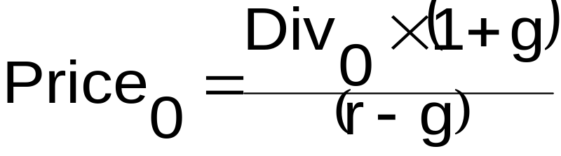
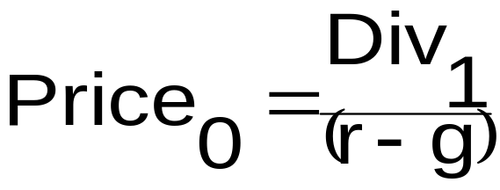
The Constant Growth Dividend Model with an Infinite Horizon (Gordon Model)
With some algebra, this can be simplified to….
And since Div₀ x (1+g) = Div₁
Or more generally P_{n} = Div_{n+1}/(r-g)

Slide 96
The Constant Growth Dividend Model with an Infinite Horizon (Gordon Model) (Cont’d)
Example 2: Constant growth rate, infinite horizon (with growth rate given).
Let’s say that the Peak Growth Company just paid its shareholders an annual dividend of $2.00 and has announced that the dividends would grow at an annual rate of 8% forever. If investors expect to earn an annual rate of return of 12% on this investment how much would they offer to buy the stock for?

Slide 97
The Constant Growth Dividend Model with an Infinite Horizon (Gordon Model) (Cont’d)
Example 2 Answer
Div₀ = $2.00; g=8%; r=12%
Div₁=Div₀*(1+g)
➔Div₁=$2.00*(1.08)➔Div₁=$2.16
P₀ = Div1/(r-g)➔$2.16/(.12 - .08)➔$54
Price₀ = $54
Note: r and g must be in decimals.

Slide 98
Preferred Stock
Pays constant dividend as long as the stock is outstanding.
Typically has infinite maturity, but some are convertible into common stock at some pre-determined ratio.
Have “preferred status” over common stockholders in the case of dividend payments and liquidation payouts.
Dividends can be cumulative or non-cumulative
To calculate the price of preferred stock, we use the PV of a perpetuity equation, i.e. Price₀ = PMT/r
PMT = Annual dividend (dividend rate * par value); and
r = investor’s required rate of return.

Slide 99
Preferred Stock (Cont’d)
Example 3: Pricing preferred stock.
The Mid-American Utility Company’s preferred stock pays an annual dividend of 8% per year on its par value of $60. If you want to earn 10% on your investment how much should you offer for this preferred stock?
Answer
Annual dividend = .08*$60 = $4.80
Price = $4.80/0.10 = $48

Slide 100
Efficient Markets
Market in which security prices are current and fair to all traders.
Transactions costs are minimal.
There are two forms of efficiency:
    Operational efficiency and
    Informational efficiency.

Slide 101
Operational Efficiency
Speed and accuracy with which trades are processed.
Ease with which the investing public can access the best available prices.
  The NYSE’s SuperDOT computer system,
  NASDAQ’s SOES
Match buyers and sellers very efficiently and at the best available price.
Therefore definitely very operationally efficient markets.

Slide 102
Informational Efficiency
Speed and accuracy with which information is reflected in the available prices for trading.
Securities would always trade at their fair or equilibrium value.
  Diverse information -- financial economists have come up with three versions of efficient markets from an information perspective:
  weak form,
  semi-strong form,
  strong form.
These three forms make up what is known as the efficient market hypothesis (EMH).

Slide 103
Informational Efficiency (Cont’d)
Weak-form efficient markets :
  Current prices reflect past prices and trading volume.
  Technical analysis – not useful
Semi-strong-form efficient markets:
  Current prices reflect price and volume information and all available relevant public information as well.
  Publicly available news or financial statement information not very useful.
Strong-form efficient markets:
  Current prices reflect price and volume history of the stock, all publicly available information, and even all private information.
  All information is already embedded in the price--no advantage to using insider information to routinely outperform the market.
Jury is still out, evidence is not conclusive!

Slide 104
Technical Analysis

Slide 105
Assumptions
Values and thus prices are determined by supply and demand
The market discounts everything
Price moves in trends
History tends to repeat itself
Supply and demand is driven by both rational and irrational behavior
Security prices move in trends that persist for long periods of time
While the cause for changes in supply and demand are difficult to determine, the actual shifts in supply and demand can be observed in market price behavior

Slide 106
Trend Analysis: Samples
Dow Theory
  it states that stock prices move in trends; a stock price is more likely to continue a past trend than move erratically
  3 types of trends: major trends, intermediate trends, and short-run movements
  Technicians look for reversals and recoveries in major market trends

Slide 107
Trend Analysis: Samples
Support and Resistance Levels
  Most stock prices remain relatively stable and fluctuate up and down from their true value
  The lower limit to these fluctuations is called a support level – the price range where a stock appears cheap and attracts buyers
  The upper limit is called a resistance level – the price range where a stock appears expensive and initiates selling

Slide 108
Trend Analysis: Samples
Moving Average Lines
  Technicians believe stock prices move in trends
  Random fluctuations in prices mask these trends
  By using moving averages (10 to 200 days) technicians can eliminate the minor blips from graphs but retain the overall long-run trend in prices

Slide 109
Trend Analysis: Samples
Relative Strength
  If two variables are changing at the same rate, the ratio created by dividing one of the variables by the other will remain constant
  Relative Strength = Stock Price/Market Price
  If the ratio increases over time the stock is out-performing the market (a + trend)
  If the ratio declines over time the stock is under-performing the market (a – trend)

